Slide 1


Slide 2
Impacts of road grade on fuel consumption of light vehicles by use of Google Earth DEM
Reporter : Yanni Wang
Affiliation:Beihang University,
Beijing,China

Slide 3

Contents:
1.Background
3.Evaluation of Road Grade
4.DataSet
2.Related Work
5.Sensitivity of Fuel Consumption to Road Grade

Slide 4
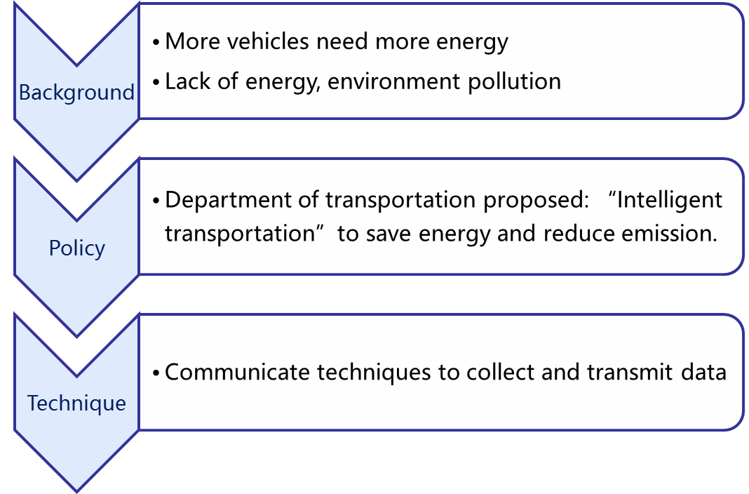
Background

Slide 5
Related Work
CMEM : 46 parameters(too many).
VT-Micro 、EMIT : don't take road grade into consideration.
Melissa : compared fuel consumption with and without road grade.
Notes:
Melissa:compared the
fuel consumption when taking road grade into consideration
with the case without road grade, and chose the path between
an O-D (Origin-Destination) which consumed less under the
two circumstances, we may
probably make a wrong choice without considering road
grade

Slide 6
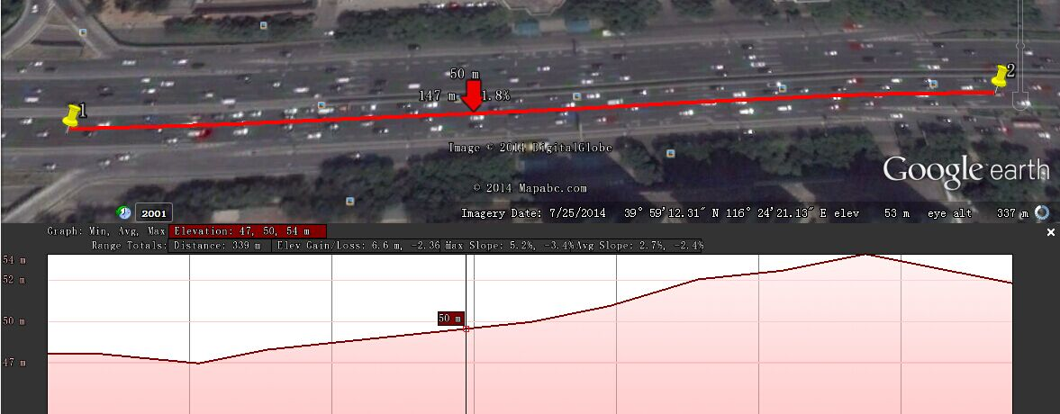
Evaluation of Road Grade
How to get the elevation of a point on the map?
Load the vector map of Beijing road network;
Select the road links according to the link ID;
Generate the Key Markup Language file;
Call the Google Earth DEM to get the path information from the file in step 3 and extract the elevation data

Slide 7
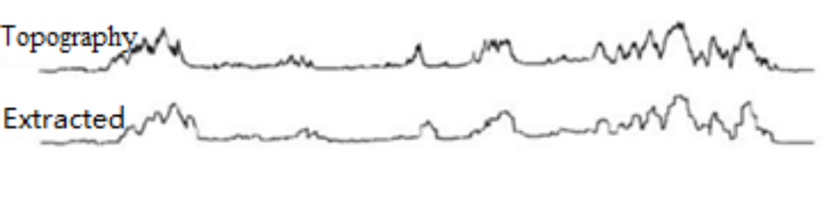
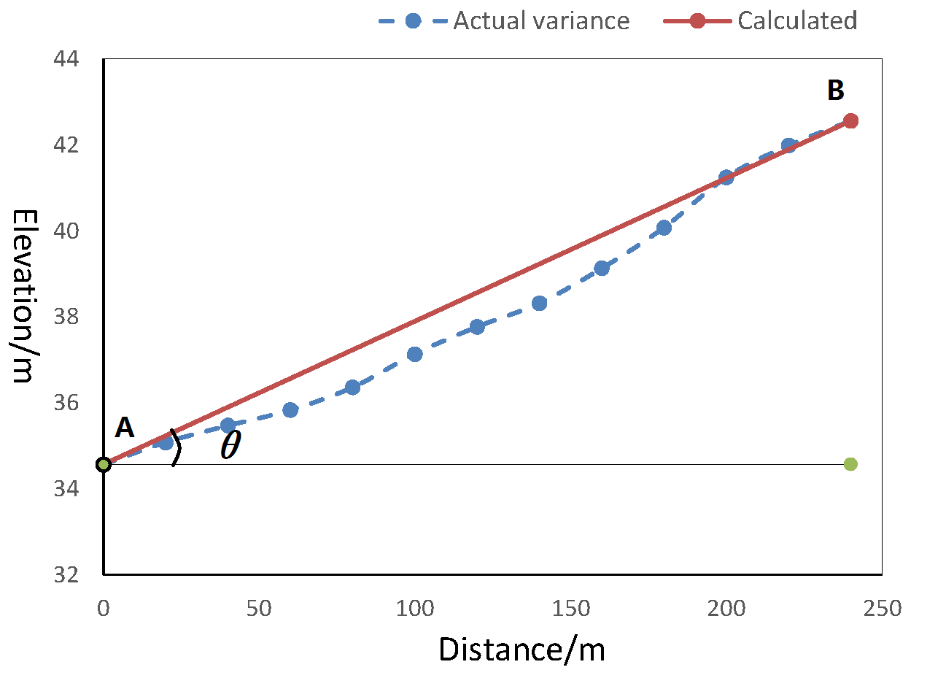
Evaluation of Road Grade
For each link, we define it as:
C = (cid,d,P1,…,Pn)
cid : link number;
P1…Pn : nodes after
division;
Gradient of a Link:
tanθ= (E_{n}-E₁)/l
En : the elevation of B
En : the elevation of A
l : horizontal distance of A
and B

Slide 8
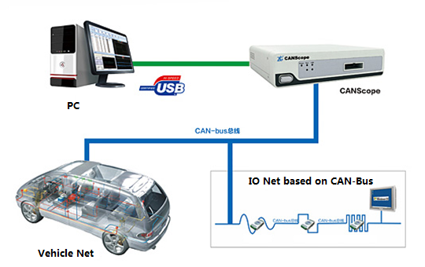
DataSet Description
Data collected by CAN:
1) Vehicle ID
2) Instant speed
3) Acquisition time
4) Latitude and longitude)
5) Distance in a second
6) Instant fuel consumption

Slide 9
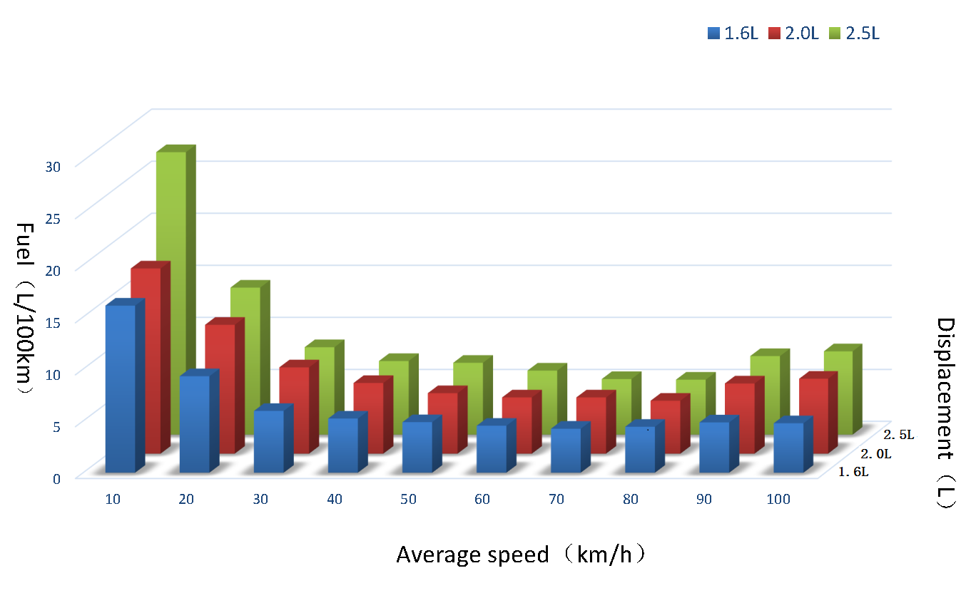
Dataset Description
Other data:
1) Vehicle type
2) Vehicle weight
3) Displacement

Slide 10
Sensitivity of Fuel to Road Grade
01
The relationship of speed and fuel consumption
02
Impact of
road gradient on fuel
01
01
01
01
03
Impact of driving style on fuel consumption

Slide 11
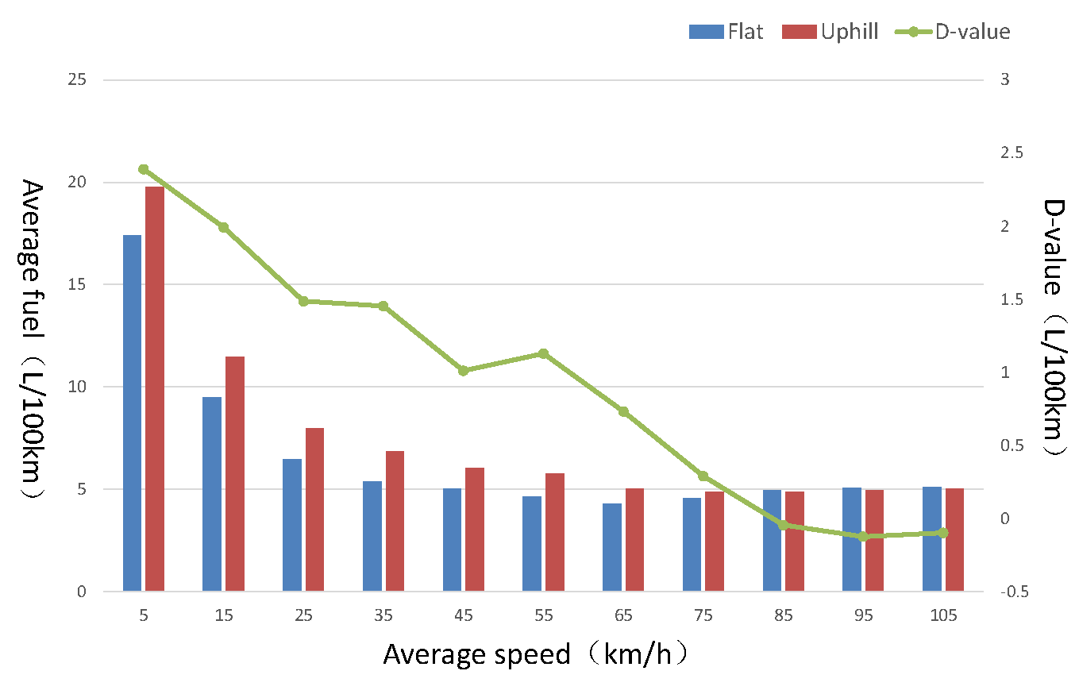
Relationship of speed and fuel consumption
Low speed [0,25km/h] | Traffic jam | High fuel consumption
 | Frequent starts and stops
 | Different driving style
Middle speed [35,65km/h] | Better traffic | Low fuel consumption
 | Uniform driving
 | Fuel burn exactly
High speed [65,100km/h] | Uniform driving | Low fuel consumption
 | Inertia driving

Slide 12
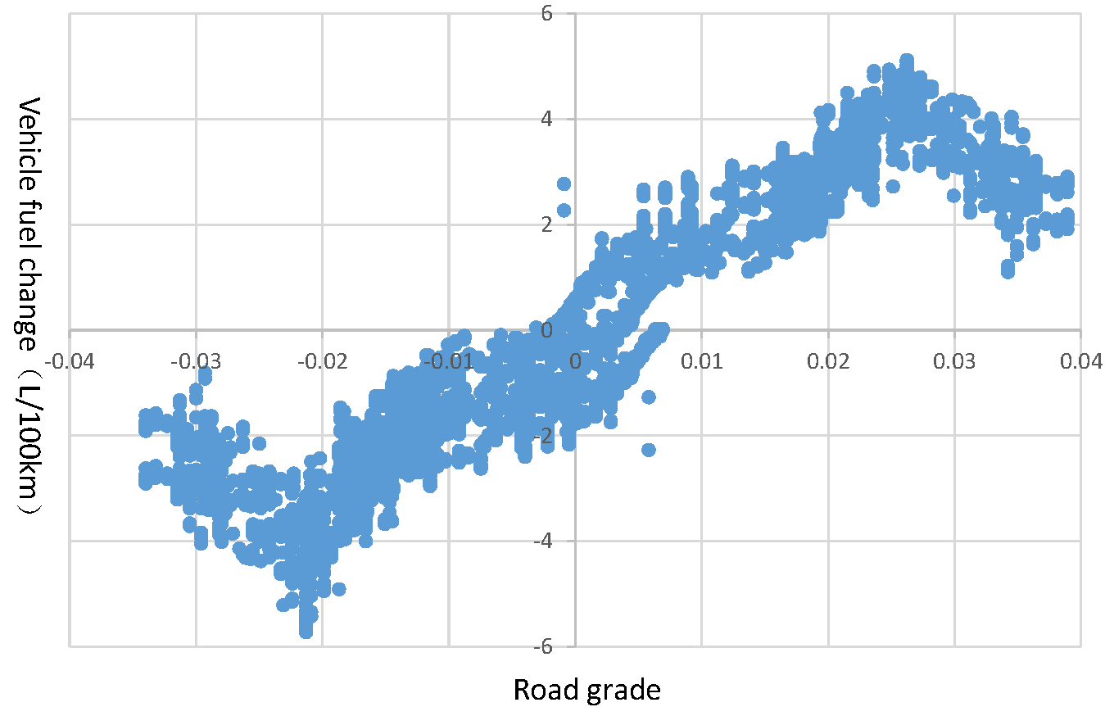
Impact of road gradient on fuel
Uphill | Constant gas | Higher fuel consumption
 | Overcome the gravity
Downhill | Inertia driving | Lower fuel consumption
 | Little gas
Uphill-milestone：2.6%
Before 2.6% : quick gas leads to fuel burn incompletely;
After 2.6% : high speed brings a inertia;
Downhill-milestone：-2.13%
Before -2.13% : Inertia driving needs little gas;
After -2.13% : Under high speed, vehicle need to brake, fuel burn incompletely.

Slide 13
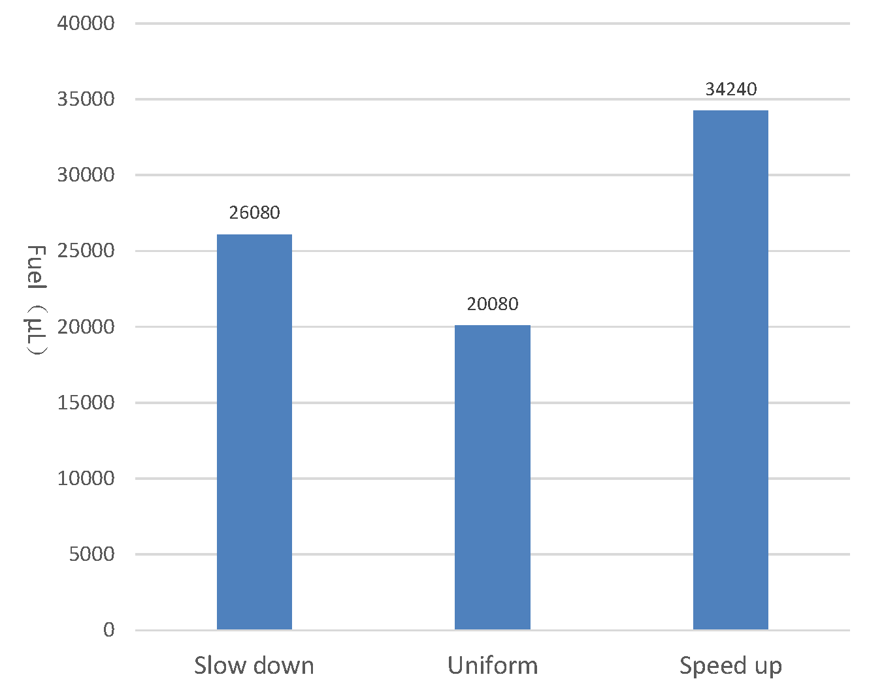
Impact of driving style on fuel
Speed down:
More travel time;
More brakes lead to fuel burn
Incompletely.
Speed up:
More fuel is needed to support
a decreasing speed;
Less travel time;
Uniform:
Do a compromise of traveling time
and the engine’s work

Slide 14
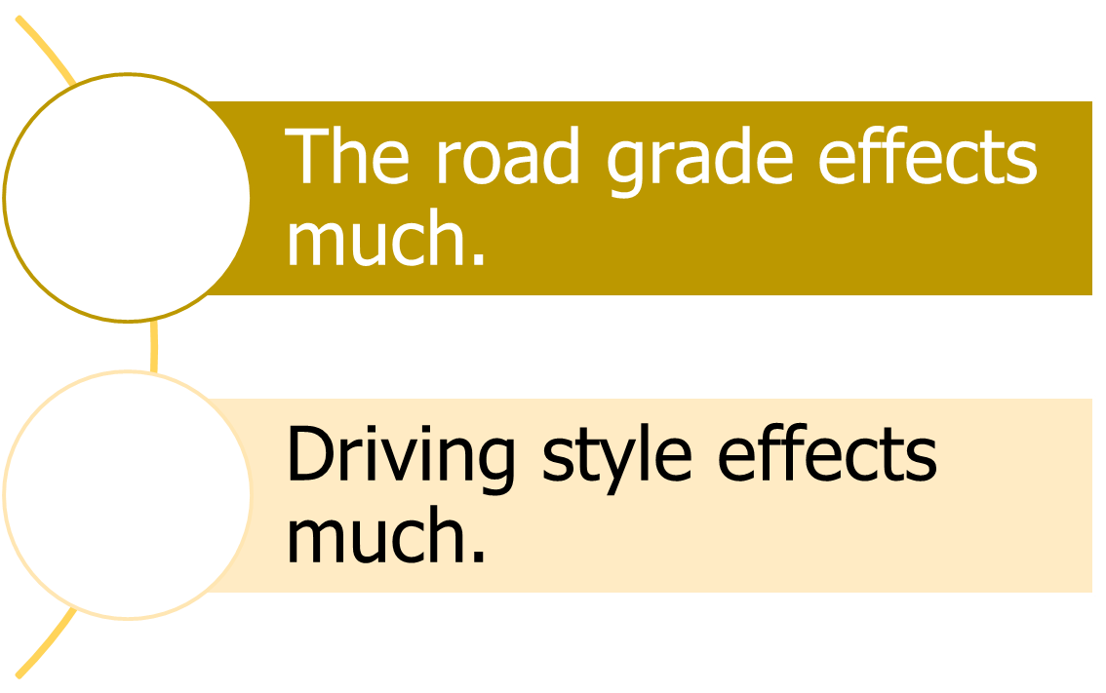
Conclusion

Slide 15
References
[1] Motor Vehicle Pollution Control Annual Report of China,2013
[2] Barth.M, F.An, T. Younglove. Comprehensive Modal Emissions Model(CMEM), Version 2.0, User’sGuide[R]. Califormia: Univ. of California Riverside, 2000
[3] Rakha H, Ahn K, Trani A. Development of VT-Micro model for estimating hot stabilized light duty vehicle and truck emissions[J]. Transportation Research Part D: Transport and Environment, 2004, 9(1): 49-74.
[4] Guo C, Ma Y, Yang B, et al. EcoMark: evaluating models of vehicular environmental impact[C]// Proceedings of the 20th International Conference on Advances in Geographic Information Systems. ACM, 2012:269-278.
[5] Cappiello A, Chabini I, Nam E K, et al. A statistical model of vehicle emissions and fuel consumption[C]//Intelligent Transportation Systems, 2002. Proceedings. The IEEE 5th International Conference on. IEEE, 2002: 801-809.
[6] Boriboonsomsin, K., Barth, M., 2009. Impacts of road grade on fuel consumption and carbon dioxide emissions evidenced by use of advanced navigation systems. Transp. Res. Rec. 2139, 21–30.

Slide 16
References
[7] Duell M, Levin M W, Waller S T. The impact of road grade on city-wide vehicle energy consumption and eco-routing[C]//Conference of Australian Institutes of Transport Research (CAITR), 32nd, 2014, Sydney, New South Wales, Australia. 2014.
[8] Boroujeni B Y, Christopher Frey H. Road grade quantification based on global positioning system data obtained from real-world vehicle fuel use and emissions measurements[J]. Atmospheric Environment, 2014, 85(1):179–186.
[9] Ren S, Li X, Liu X. The 3D Visual Research of Improved DEM Data Based on Google Earth and ACIS[M]//Pervasive Computing and the Networked World. Springer International Publishing, 2014: 497-507.
[10] Google(2014).Google(2014)Google earth.[EB/OL],http://www.google.cn/intl/zh-CN/earth/.
[11] Tong, Yongxin, Chen, Lei, Cheng, Yurong, et al. Mining Frequent Itemsets over Uncertain Databases[J]. Proceedings of the Vldb Endowment, 2012, 5(11):1650-1661.
[12] Ahn K, Rakha HA (2013) Network-wide impacts of eco-routing strategies:a large-scale case study. Transp Res Part D Transp Environ25:119–130.

Slide 17
Thank you！

